Slide 1


Space Products
S
p
a
c
e
E
l
e
c
t
r
o
n
i
c
s
Laura Malleret
HO Advanced Projects, sales, bid and strategy for Space Electronics
03/2026

Slide 2

Who we are
[ Airbus Amber ]
Space Electronics belongs to Space Products, an Airbus Defence and Space Business Unit,
Space Products is a preferred supplier of space equipment and services, serving the worldwide market.
We deliver innovative solutions for a safe and sustainable space environment.
2
© Copyright Airbus Defence and Space 2025 / Airbus Space Products Corporate Presentation
Notes:
I/ Who we are
Space Products, an Airbus Defence and Space Business Unit, is a preferred supplier of space equipment and services, serving the worldwide market through its own brand as well as the Jena-Optronik and TESAT brands.
Equipment defines a spacecraft’s capabilities.
Combining a long heritage with a New Space mindset, we are your trusted global partner to make your vision fly, focused on helping our customer achieve their missions.
II/ Our vision
We deliver innovative solutions for a safe and sustainable space environment.

Slide 3






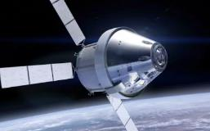




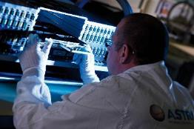

Space Electronics
A Space Products entity
Space Electronics key figures & facts
Worldwide Supplier of electronic units, sensors & actuators for Space Applications
Paris
Integrated Electronics supplier
Elancourt
Hi-Rel / Commercial parts, selection, procurement, test
400
France workforce
> 1500 boards /y
> 300 unit /y
EEE
Toulouse
Radiation expertise
Electronics design house and chamber of reference
Space Agencies
Start-up, medium & big size companies
Institutions and Defence Agencies
Satellite Operators
Test facilities: Thermal, Vibration, EMC
Governments, institutional and enterprises from multiple areas/ fields
EGSE design house
Full automatic assembly line SnPb and lead free
120 M€
Revenues
> 40% Export
© Copyright Airbus DS SAS 2025

Slide 4
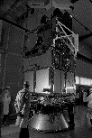









Space Electronics
A Space Products entity
Space Electronics long stage heritage & strong pillar within Airbus Space Systems
From Matra Marconi Space and Aerospatiale in the 70’s -90’s
to Space Products, an Airbus Defence and Space Division
In 1980’s
2010
2018
Matra introduces digital ASICs in satellite designs, typically on SPOT1
First Fiber Optical Gyroscope (FOG) in orbit
First Astrix 1090 in Orbit
1965
2012
2019
26th Nov.: First in-orbit injection of the French Astérix satellite (40kg/55cm) engineered by former SpE members; Matra Cie.
Early 1990’s
Introduction of Oscar On-Board computer for observation & exploration missions based on SCOC3 processor designed by Airbus flying first on SPOT6
First OneWeb satellite in flight with On-Board Computer & Electric Propulsion fully designed with COTS by Airbus
Introduction of FPGA (Actel A1020) on SILEX: The First European Optical
Communication Terminal in Orbit
2014
One of a kind entity
within Space Product
In 1970’s
Early 2000’s
Mostly analog spacecrafts with introduction of some digital functions
Introduction of Nand Flash Memory for mass memory function on Astroterra mission
Introduction of flash FPGA, followed by SRAM FPGA, generalisation of plastic COTS and HDI printed circuit board
Market Leader on: Digital Products / Power Products / Sensors & Actuators
Be the electronic center of excellence for Next Space and Conventional Space
© Copyright Airbus DS SAS 2025

Slide 5
















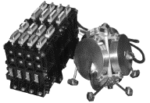


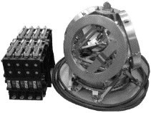






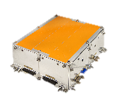

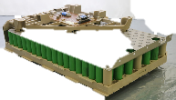
Space Electronics
A Space Products entity
Space Electronics reliable & large unit portfolio
Power & Propulsion Units
Electric Propulsion
Power Distribution & Regulation
Platform & Payload Processing Units
On-board Computers
Ciphering unit
Payload Data Handling unit
Sensors & Actuators
Fiber Optic Gyroscopes
Control Moment Gyroscope
Detumbler
Batteries
Launcher
Constellations
LEO MEO / GEO
© Copyright Airbus DS SAS 2025

Slide 6
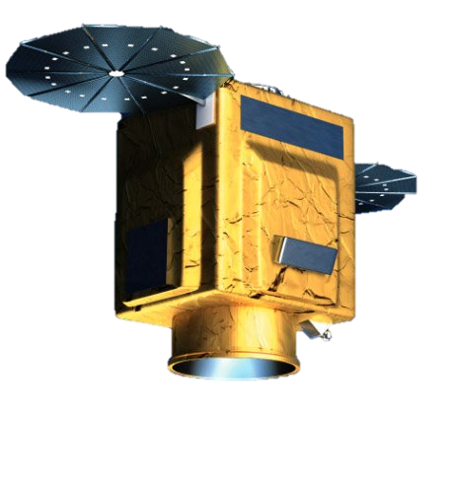





Space Electronics
A Space Products entity
Our Products for Earth Observation, Science & Exploration Satellites
Platform & Payload Processing Units
Sensors & Actuators
On-board computers:
Optical Fiber Gyroscopes: Astrix family
CQ 1/2
COTS
CQ 1/2
CQ 1/2
Oscar family
OBC Amethyst
Astrix 120
CQ 1/2
Astrix 200
Security
Propulsion
Astrix 1090A
CQ 1/2
COTS
Agility: CMG family
PPU TOPAZ 300W
CQ 1/2
CQ 1/2
IDCU family
CQ 1/2
Payload Data Handling: Nemo & Coreci family
HCA 4-1
CMG 15-45
CQ 1/2
CQ 1/2
CQ 1/2
CQ 1/2
CQ 1/2
Coreci 2
Nemo 2
CMG 40-60
CMG HP
Flight Proven
Ready for flight
Under qualification
© Copyright Airbus DS SAS 2025

Slide 7
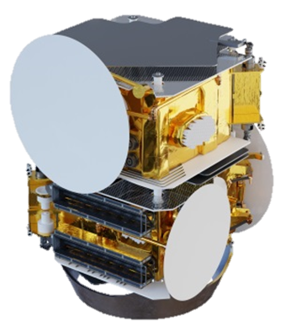






Space Electronics
A Space Products entity
Our Products for Telecom Satellites
Platform & Payload Processing Units
Power & Propulsion
On-board computers & Payload Interface unit: CMDU/PLIU family
Power Propulsion Unit
CQ 1/2
CQ 1/2
CQ 1/2
COTS
COTS
COTS
CDMU
PIU
1st Generation
2nd Generation
Sensors & Actuators
Power Supply Regulator
COTS
CQ 1/2
COTS
CQ 1/2
Astrix NS
Astrix 1090
PSR MKII
Smart PCU
Flight Proven
Ready for flight
Under qualification
Next Generation
© Copyright Airbus DS SAS 2025

Slide 8
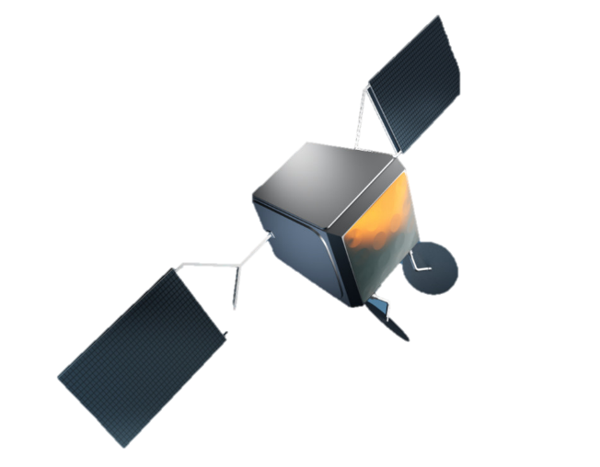

Space Electronics
A Space Products entity
Our Products for Constellations & Small Satellites
Platform & Payload Processing Units
Power & Propulsion
COTS
COTS
COTS
COTS
PPU TOPAZ 300W
PPU TOPAZ 1kW
OBC Amethyst
OBC 500
COTS
Sensors & Actuators
Security: IDCU family
COTS
Astrix NS
8
Flight Proven
Ready for flight
Under qualification
Next Generation
© Copyright Airbus DS SAS 2025

Slide 9

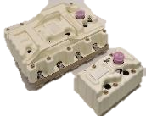
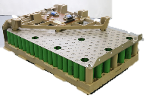
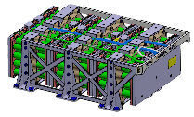
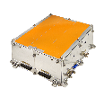

Space Electronics
A Space Products entity
Space Products – Battery Storage portfolio
COSMO-BATT
ASTRO-BATT
STELLAR-BATT
LAUNCHER-BATT
    70+ modules in orbit
    250+ produced
TRL7
Qualification mid-2024
    630+ in orbit
    850+ ordered
    1st launch mi-2024
    100+ produced,
FM in production
Launched
Flying
Flying
New
GEO/MEO
TELECOM
AND NAV. BATTERIES
LEO/GEO OPTICAL/RADAR SATELLITES BATTERIES
CONSTELLATIONS BATTERIES
LAUNCHERS
BATTERIES
9
© Copyright Airbus DS SAS 2025
Notes:
2 PPUs flying : NG2 for GEO missions and Topaz on board Oneweb
NG2 for GEO missions
NS = Topaz’s little sister

Slide 10
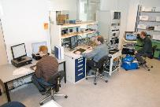
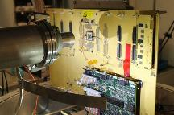
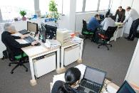
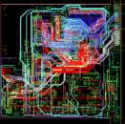

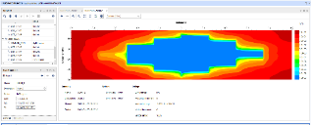
Space Electronics
A Space Products entity
Product Development Capabilities, Skills & Competencies
Technologies & Assembly process qualification
Mechanical Design & Analysis
Electronic Design
Equipment Test Design (Ground system)
Component Qualification (EEE) & Radiation Analysis
Project Management, Quality & Finance
10
© Copyright Airbus DS SAS 2025

Slide 11
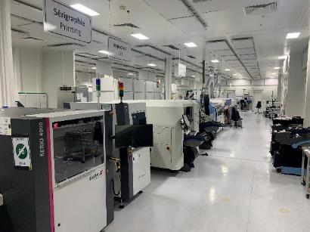
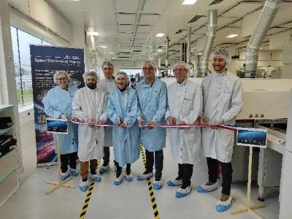
Space Electronics
A Space Products entity
Industrial Capabilities, Skills & Competencies
Fully automated production capacities in clean room environment:
          Capacity demonstrated up to 1500 boards manufactured / year
          Mix Tin-Lead & Lead free assembly process
          Target to reach > 5000 boards / year → New production line installed (PID revalidation in process). Used from April ’25 onwards on OneWeb Gen1R (Amethyst)
Assembling workshop with up to class 100 laminar flows
Test facilities in clean room environment
Thermal & thermal vacuum chambers
Vibration test jigs
EMC chamber
3 axes rotary table 3D measurement machine embedding thermal vacuum (accuracy 1 micron)
11
© Copyright Airbus DS SAS 2025

Slide 12
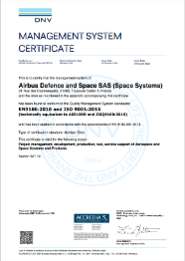
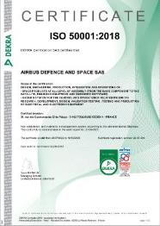
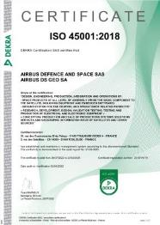
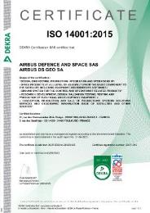
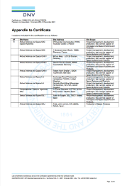
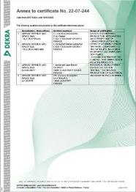
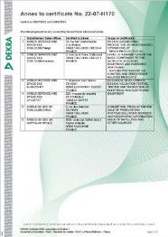
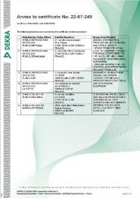
Space Electronics
A Space Products entity
Certified Industrial Capabilities, Compliant to Industry Standards
Space Electronics premises (Q1-Q2 line compliant to ESA & CNES class 1 rules and associated processes) are identified as production reference center for Airbus, able to deal with any automatic assembly line for electronic units addressing GEO, MEO and LEO missions
12
© Copyright Airbus DS SAS 2025

Slide 13
Space Electronics
A Space Products entity
For further information please contact us:
laura.malleret@airbus.com Head of Advanced Projects, Bid, Sales & Strategy
for Space Electronics
aurelien.dupuis@airbus.com Sales Leader for Space Electronics
eric.trehet@airbus.com PPM Power and Propulsion
regis.temperman@airbus.com PPM Platform processing
benoit.leroy@airbus.com PPM Payload processing
nicolas.deleris@airbus.com PPM Sensor and Actuators
maxime.vilmay@airbus.com PPM technology and EEE
PPM: Product Portfolio Manager
www.airbus.com/en/products-services/space/equipment
13
© Copyright Airbus DS SAS 2025

Slide 14
Back-up

Slide 15
Space Electronics Motto & Strategy
We deliver high-performance and competitive space and defense products to ensure the success of our customers' missions
Strategy 2026- 2028
Positioning | Serve the prime and defense/Earth care/constellation missions by relying on our Platform/Payload/Power/S&A pillars, our ability to interact at the system level, and an incremental product approach Maintain exports on installed REC products + push propulsion
Competitiveness | Develop product approaches, design to cost, and reuse (EGSE, FPGA/SW) Introduce AI into our daily operations and continue automation through digitalization Finalize the implementation of OES in production
Innovation | Invest ahead from developments to increase the maturity of technology building blocks (TRL6), particularly through strategic partnerships Develop or spatialize existing building blocks from other domains Maintain active monitoring of disruptive technologies.
People | Develop crypto (PQC) competencies through partnerships, strengthen digital, reliability, and radiations competencies Develop competencies in managing complex projects and outsourcing activities (e.g. SW or EGSE development work packages)

Slide 16












Space Electronics France – Advanced Projects, Bid, Sales & Strategy
Airbus Amber - Confidential
Head of Advanced Projects, Bid, Sales & Strategy
Laura Malleret
ELC
Product Portfolio Manager
Payload Products
Benoit Leroy
Sales Leader for SpE
Aurélien Dupuis
TLS
TLS
Product Portfolio Manager
Sensors & actuators
Nicolas Deleris
ArchItecte
Jean Deque
TLS
TLS
Product Portfolio Manager
Platform Products
Régis Temperman
Architecte
Yoann Charnet
ELC
TLS
Product Portfolio Manager
Power & propulsion products
Eric Tréhet
Bid Manager Referent
Philippe Dumont
ELC
ELC
Bid Manager Referent
Christophe Chaminade
Product Portfolio Manager
EEE / Techno
Maxime Vilmay
ELC
ELC
Gestion de Projet
Olivier Perier
ELC
Notes:
UK region à supprimer

